Slide 1


Design Verification COMS30026 (COMS30066 with coursework) WEEKLY LIVE SESSION – W4
Kerstin Eder
Trustworthy Systems Lab
Department of
COMPUTER SCIENCE

Slide 2
Topics W1
Introduction to DV
Verification Hierarchy
Fundamentals of Simulation-based Verification
Driving & Checking
Lab W1:
get remote access to the EDA software
teach yourself Verilog ☺

Slide 3
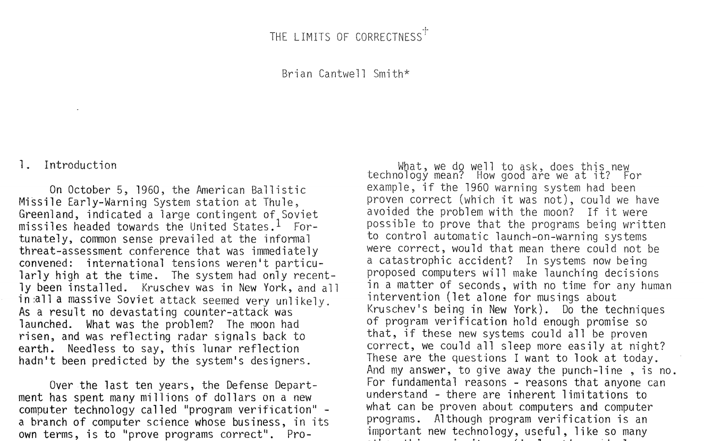
Paper review
Brian Cantwell Smith. 1985. The limits of correctness. SIGCAS Comput. Soc. 14,15, 1,2,3,4 (Jan 1 1985), 18–26.
DOI: https://doi.org/10.1145/379486.379512

Slide 4
Topics W2
Verification Tools
Hardware Design Languages
Verification Cycle, Methodology & Plan
Lab W2:
Introduction to ModelSim/Questa
installed on linux lab machines
Work through mux testbench from Exercise 2
https://uobdv.github.io/Design-Verification/

Slide 5
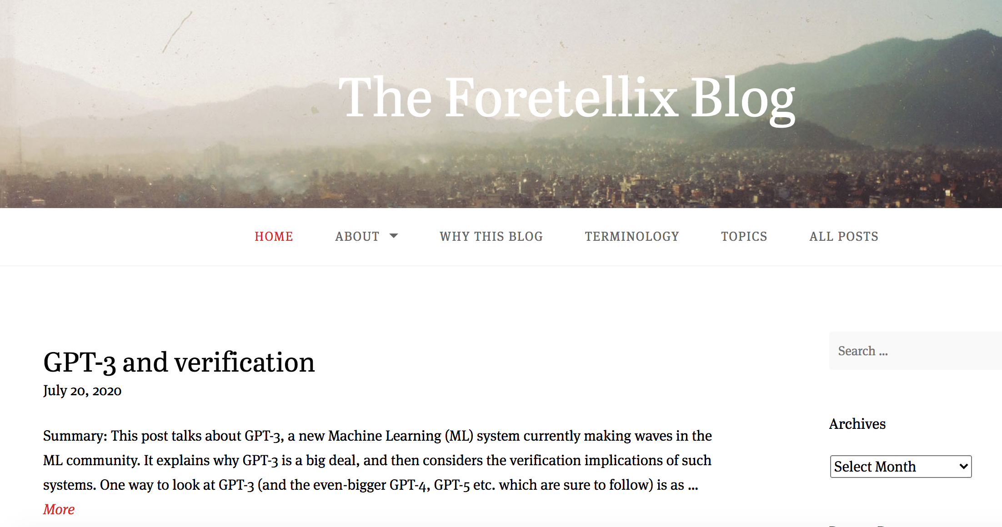
Task(s) – Week 2
Review the foretellix blog https://blog.foretellix.com/

Slide 6
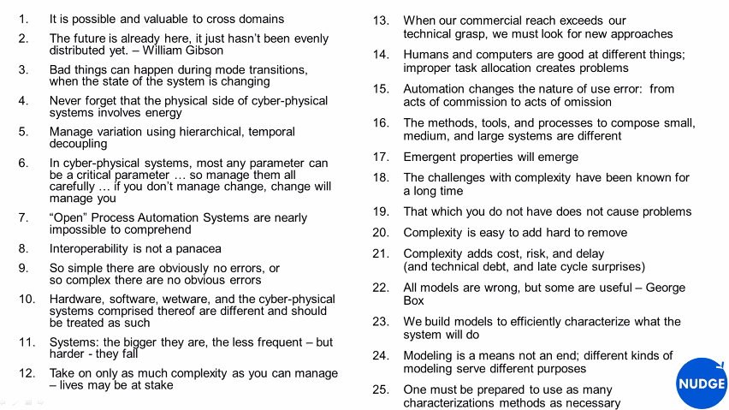
RV2020 Keynote by Lane Desborough on The Physical Side of Cyber-Physical Systems https://youtu.be/QRknQBMK9LA?t=457

Slide 7
Topics W3
Stimuli Generation Part I: Foundations
Stimuli Generation Part II: Test Automation
Checking
Lab W3:
Introduction to Practical 1 (Weeks 2-5)
Specification review
Debug calculator design using Modelsim/Questa
Example testbench on Blackboard

Slide 8
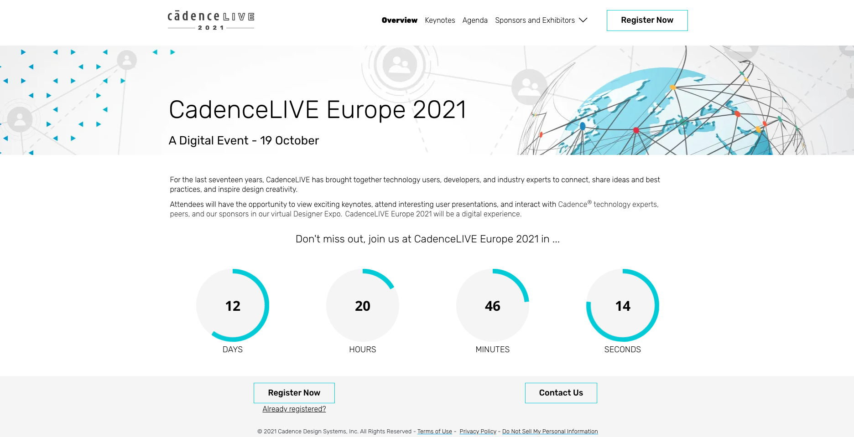
Opportunities – Week 3
CDN Live 2021 is on 19 Oct 2021
Registration is open at:
https://events.cadence.com/event/1220226a-f2b7-474c-b2a1-f08fdab24766/summary
2020 Wilson Research Group Verification Survey Results
Recording by Harry Foster on Blackboard

Slide 9
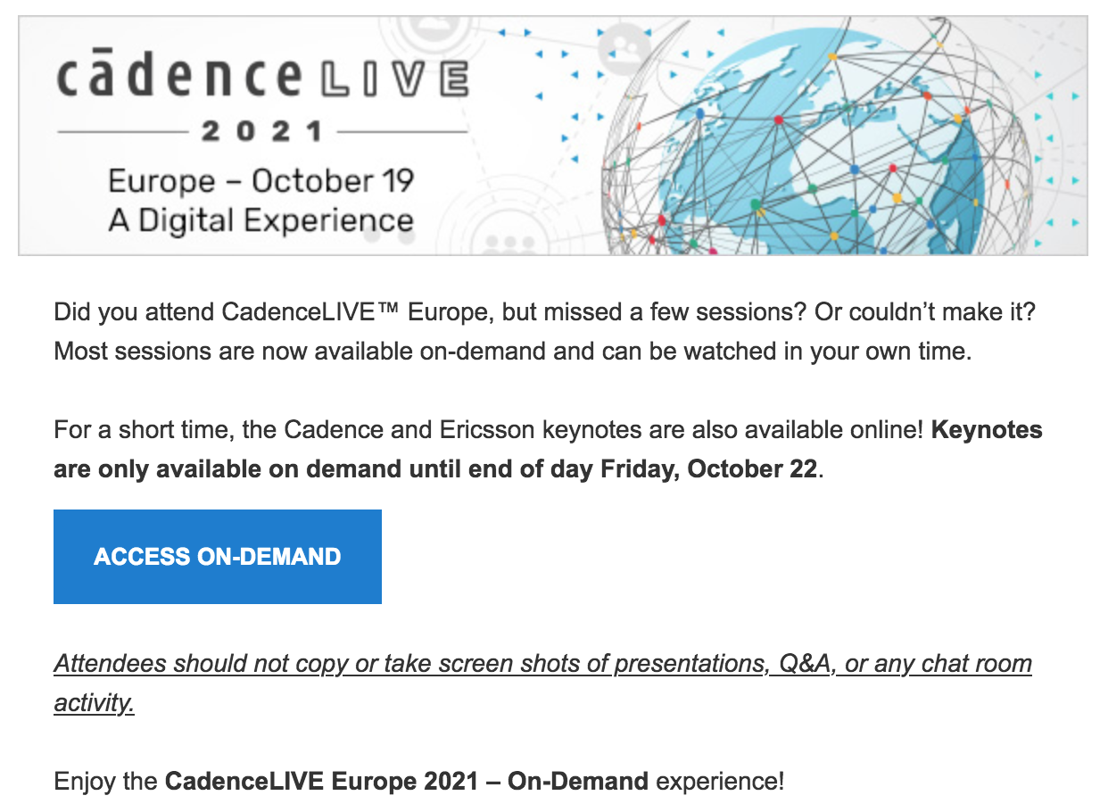

Slide 10

Challenge
Find out about the work of Edsger W. Dijkstra.
In particular, find what he said about testing and its limitations.
Photo from https://en.wikipedia.org/wiki/Edsger_W._Dijkstra

Slide 11
Challenge
Find out about the work of Edsger W. Dijkstra.
In particular, find what he said about testing and its limitations.
“Program testing can be used to show the presence of bugs, but never to show their absence!”
― Edsger W. Dijkstra
Photo from https://en.wikipedia.org/wiki/Edsger_W._Dijkstra

Slide 12
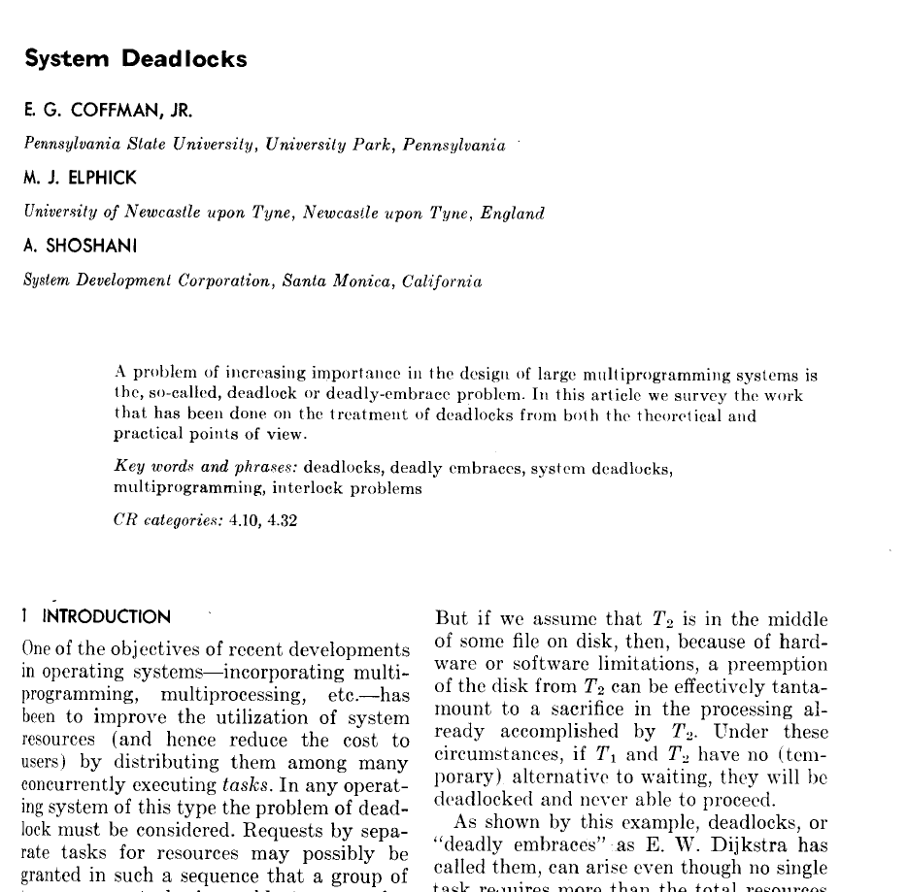
Four necessary and sufficient conditions for deadlock
E. G. Coffman, M. Elphick, and A. Shoshani.
1971. System Deadlocks.
ACM Comput. Surv. 3, 2 (June 1971), 67–78.
DOI: https://doi.org/10.1145/356586.356588
This offers you an opportunity to learn material beyond what has been taught in this unit.

Slide 13
Topics W4
Coverage Part I: Introduction and Code Coverage
Coverage Part II: Functional Coverage
Coverage Part III: Coverage Analysis
Lab W4:
Practical 1 (Weeks 2-5)
calc1 DUV provided as black box design
Specification review
Development of a Verification Plan
Debug calculator design using Modelsim/Questa
Example testbench on Blackboard

Slide 14
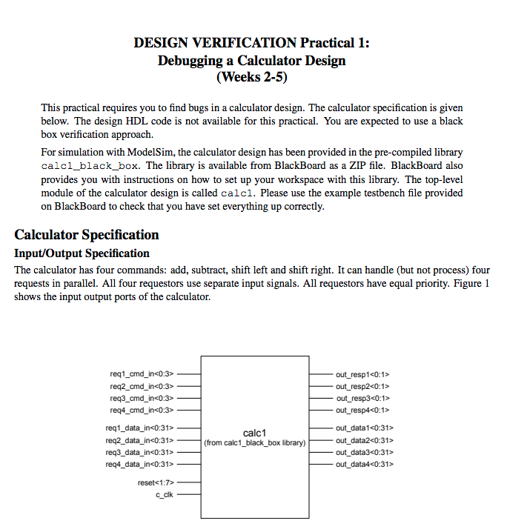

Slide 15
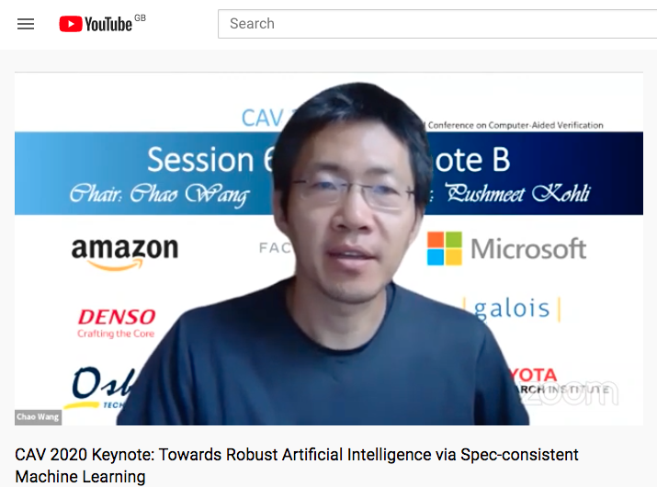
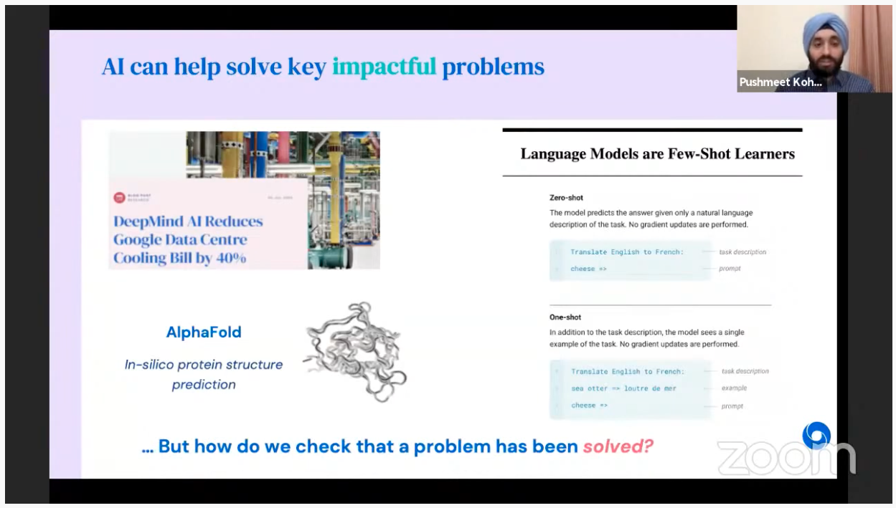
Opportunities – Week 4
CAV 2020 Keynote:
Towards Robust Artificial Intelligence via Spec-consistent Machine Learning
by Pushmeet Kohli from DeepMind
https://www.youtube.com/watch?v=25RhyyOg5Pg&feature=youtu.be

Slide 16
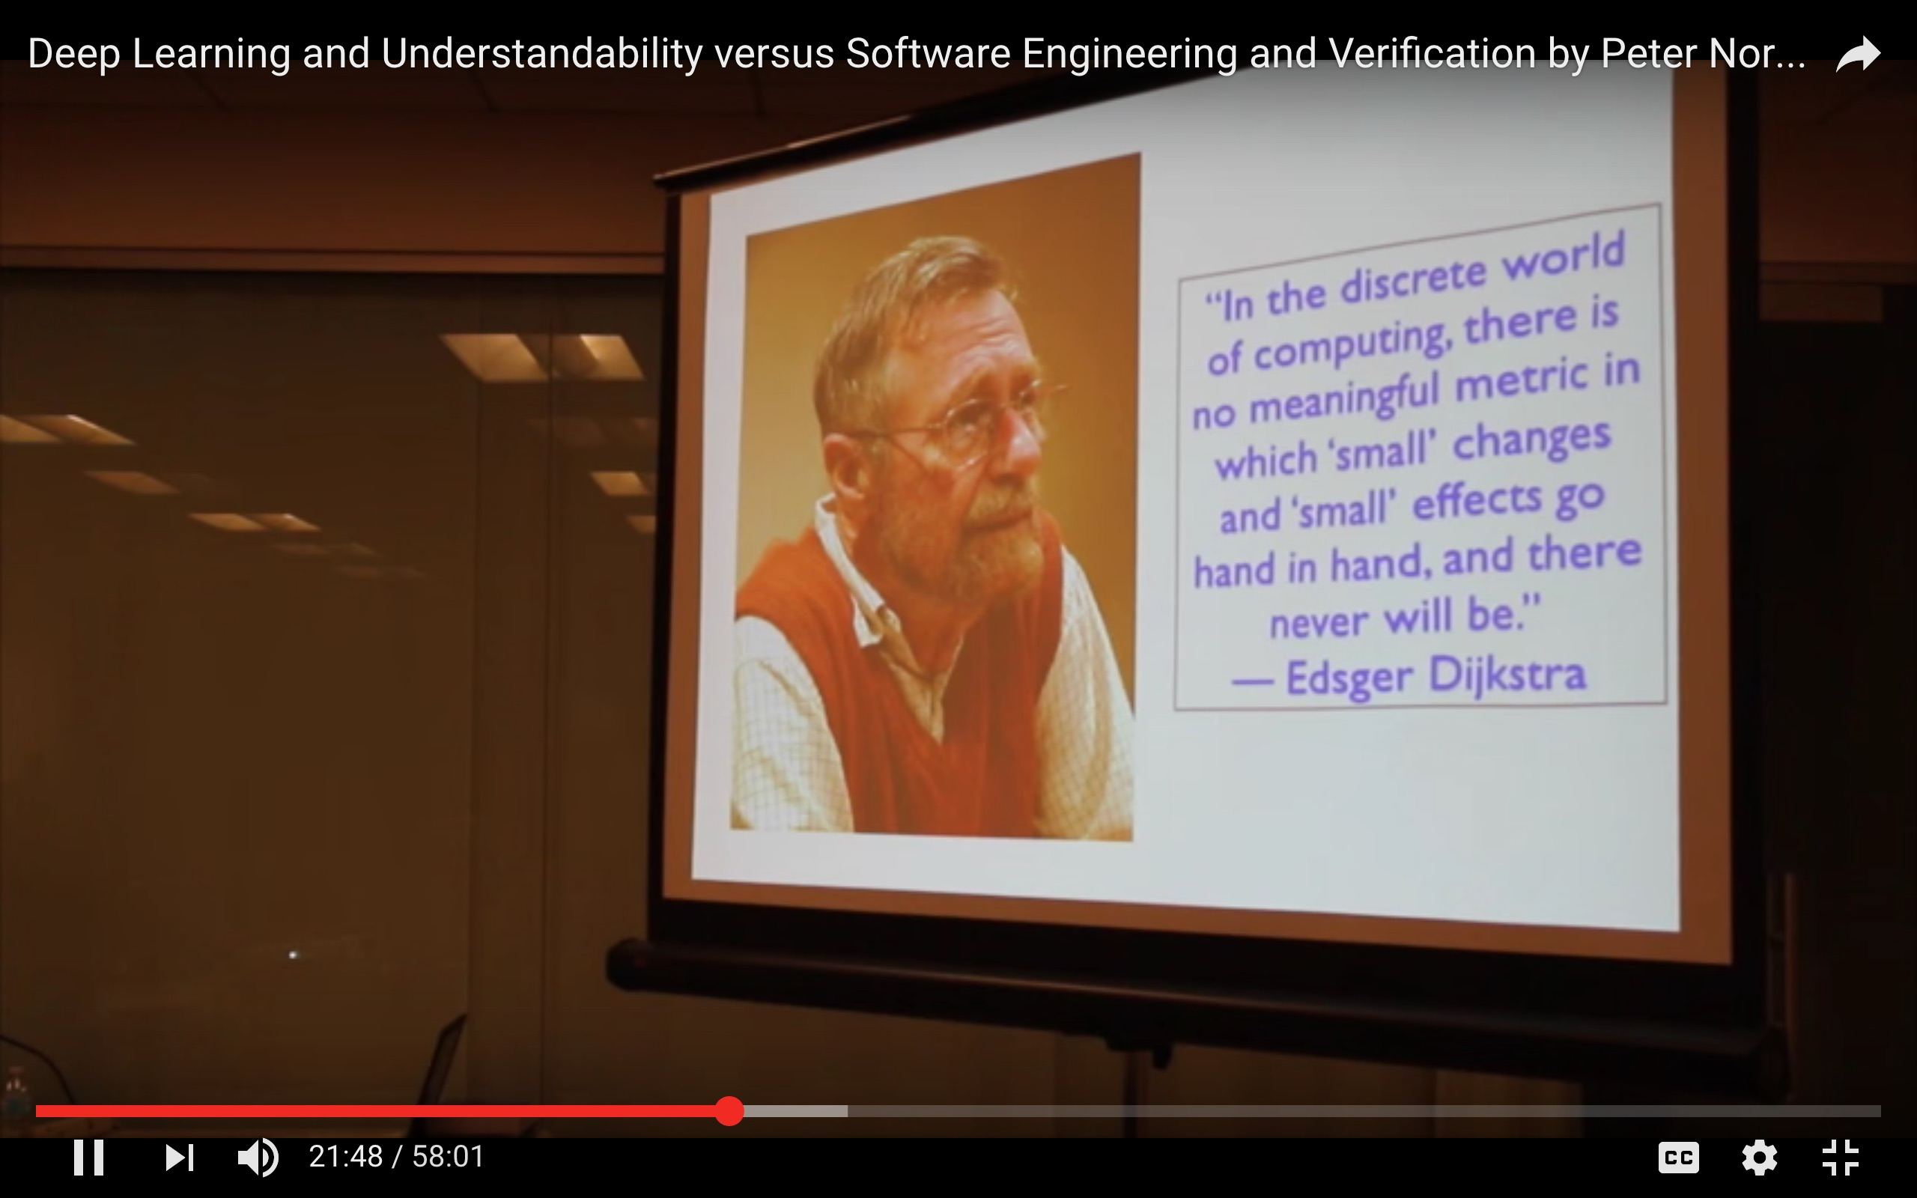
Opportunities – Week 4
Peter Norvig on Deep Learning and Understandability versus Software Engineering and Verification
https://youtu.be/3Ulh8yUiuuY

Slide 17
Next
Recordings of lectures for Week 4:
Coverage Part I: Introduction and Code Coverage
Coverage Part II: Functional Coverage
Coverage Part III: Coverage Analysis
uobdv.github.io/Design-Verification/ shows a weekly schedule of topics to watch BEFORE the next online session, ideally
Recordings are available from Blackboard unit page
Tasks for you this week:
Submit issues found during your Specification review to Blackboard Discussion Forum
Develop a Verification Plan for the calc1 black box DUV
Attend the lab session with Xuan on Friday to get help with using ModelSim/Questa so you can do Practical 1

Slide 18
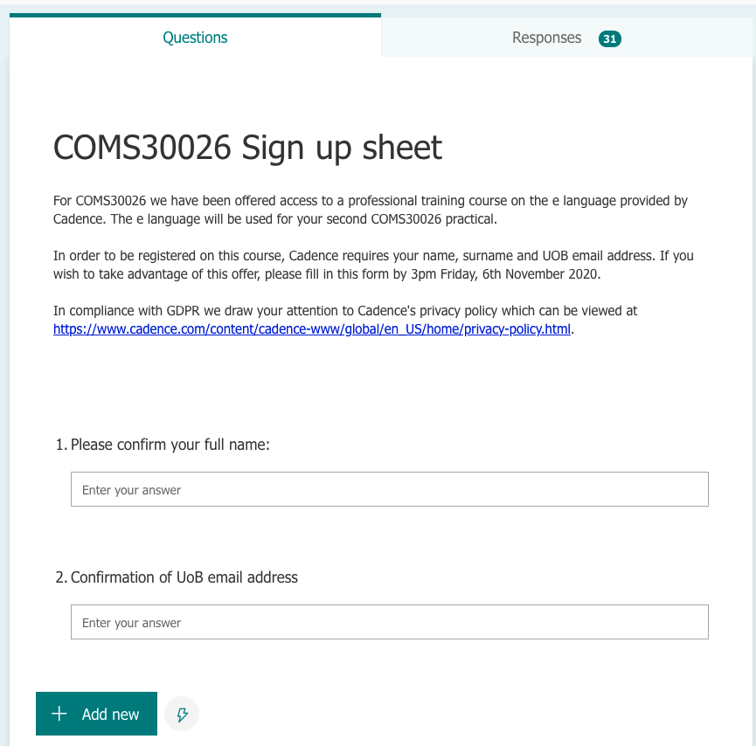

Slide 19

Questions
https://www.bristol.ac.uk/tsl

